Slide 1
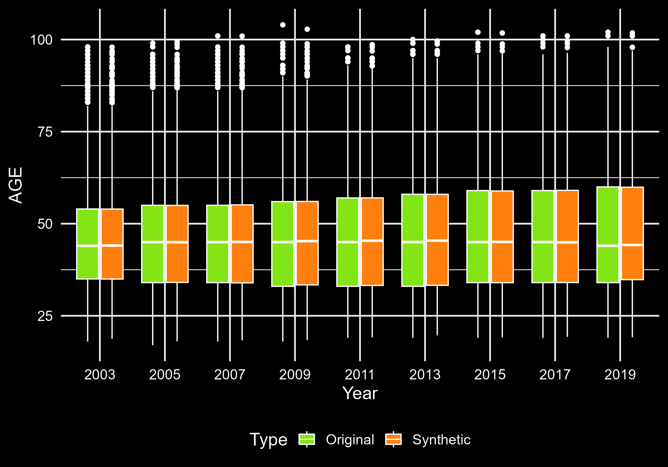

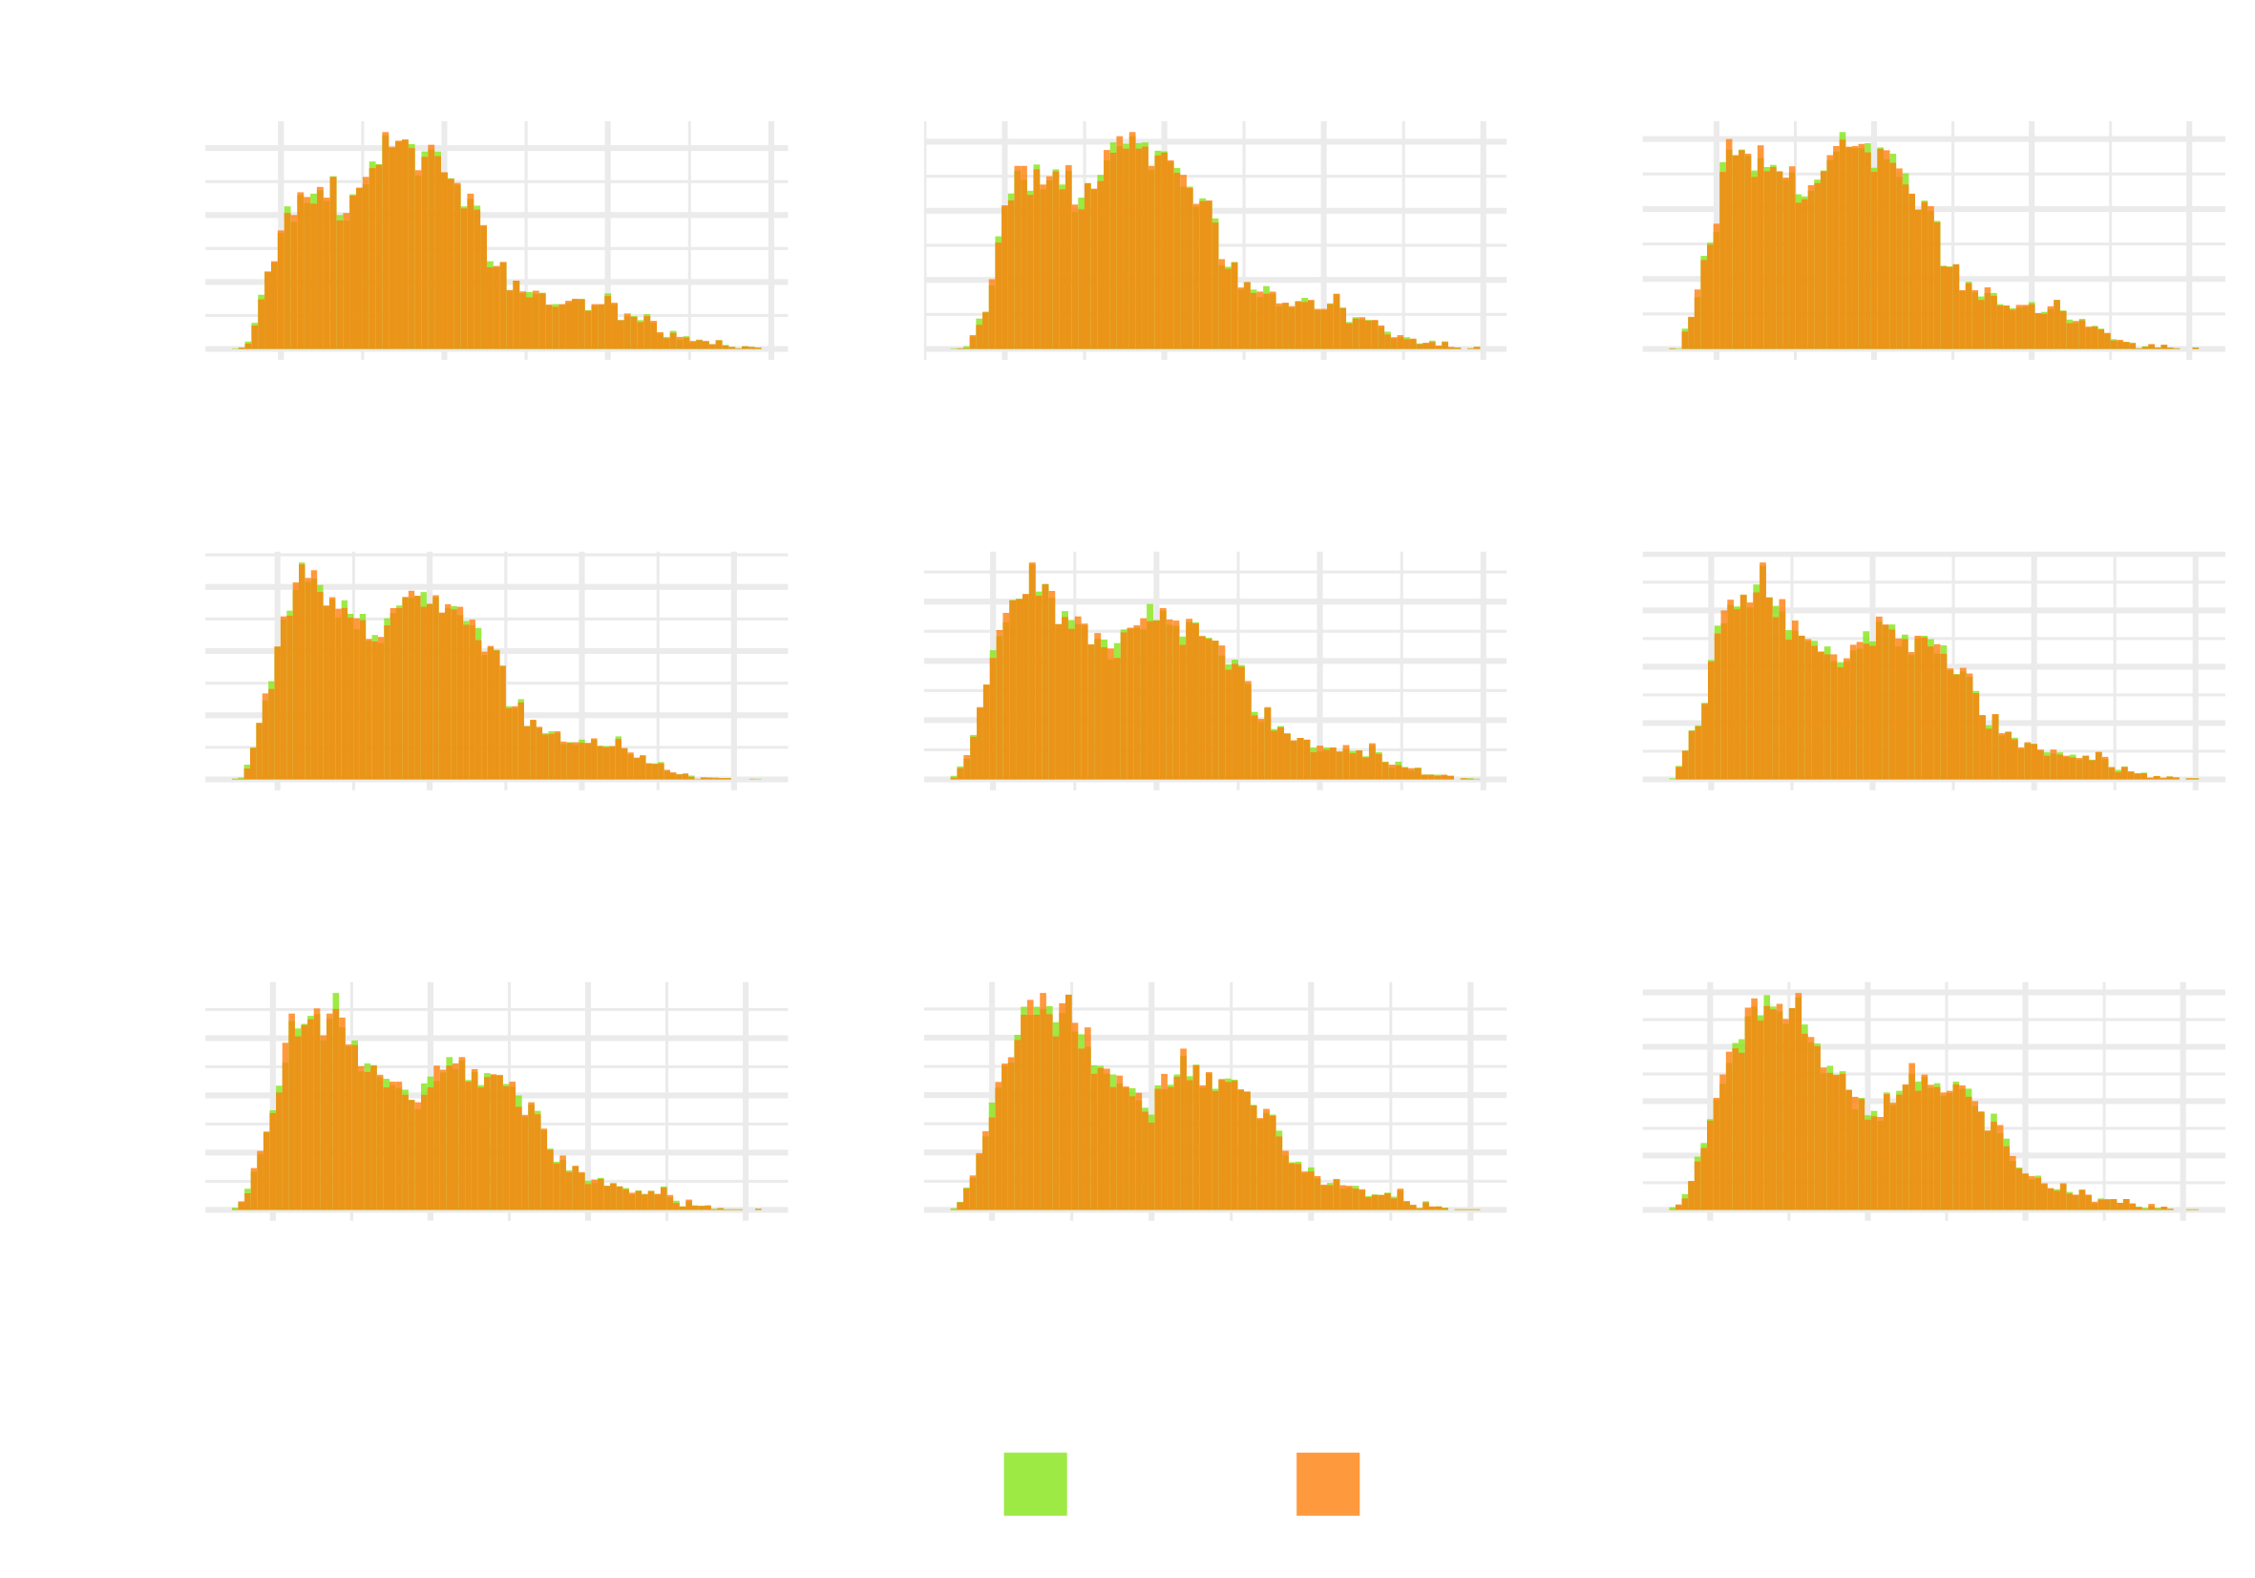
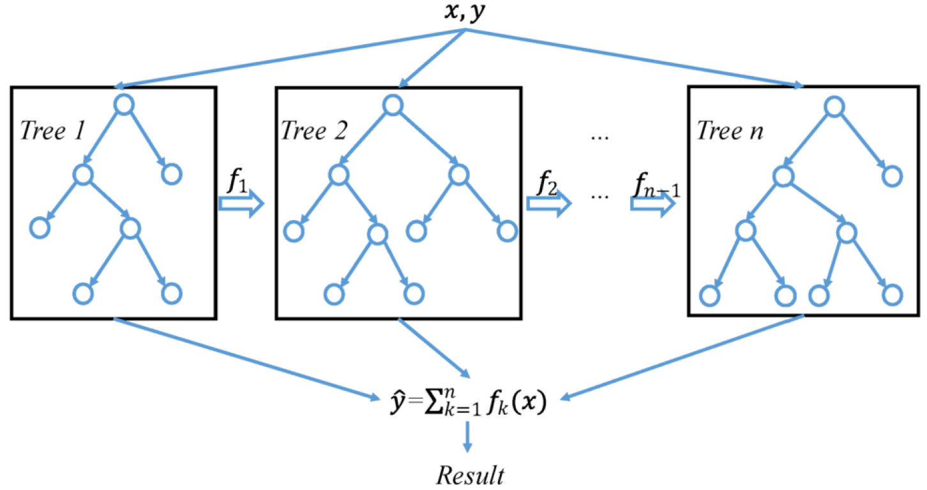







Illustrative example — PSID Data
Jiří Novák
Non-Cognitive Predictors of Student Success: A Predictive Validity Comparison Between Domestic and International Students
Anonymization of longitudinal demographic data
METHODOLOGY
A key concern with the disclosure of personal data is whether an attacker can gain any new information about an individual.
SDC is traditional approach to protecting outputs
Non-perturbation methods (reduce provided information)
Local suppression (delete high-risk records)
Global recoding (create broader categories)
Perturbation methods (modify data)
Noise masking
Record swapping
Microaggregaation
Traditional SDC methods alone are insufficient to protect longitudinal data. It is necessary to also use a more modern approach.
Synthetic data — replace some or all of the observed values by sampling from appropriate probability distributions so that the essential statistical features of the original data are preserved.
Challenges of anonymizing longitudinal data
Data Granularity ― Loss of Data Utility
Temporal Uniqueness ― Re-identification Risk
Dynamic Features ― Updating Anonymized Data
Consistency in Anonymization
In illustrative example, the synthesizer utilized the XGBoost algorithm, which was adapted for longitudinal data.
XGBoost is a distributed, optimized gradient boosting system using an iterative decision tree algorithm, with each tree learning from the residuals of previous trees.
Original vs Synthetic variable AGE by Year
Jiří Novák
- University of Zürich
- University of Applied Sciences Northwestern
Switzerland
- Swiss Data Anonymization Competence Center
BACKGROUND: Many longitudinal datasets contain demographic variables that require proper protection against disclosure.
These datasets are also invaluable sources of information for researchers in fields such as demographics, medicine, psychology, transportation, social science, economics, and many more.
To enable dissemination, we can use these methods:
Statistical Disclosure Control (SDC)
protects the data, prevents re-identification
Synthetic data generation
mimics the original data
creates artificial data that can be safely disseminated
Mobility Tracking Example
Public Health Example
Mobility in Switzerland: Microcensus on
transport behavior 2005
Open health management system in Malawi
Open Science, Open Access, Open Data
Research data that results from publicly funded research should be
findable, accessible, interoperable, reusable (‘FAIR principles’)
therefore replicable, transparent, trustworthy
as open as possible, as closed as necessary
Commission Recommendation (EU) 2018/790 on access to and preservation of scientific information
Source: (DOI) 10.1007/s10509-019-3602-4
Acknowledgments
This work was funded by the Swiss National Science Foundation with grant number 211751: "Harnessing event and longitudinal data in industry and health sector through privacy preserving technologies".
Take a picture to download
Feel free to reach out and discuss!

